Slide 1

Geometry
Unit 13, Lesson 6 Classifying Triangles Volume 2, pg. 314

Slide 2


Benchmark
MA.912.GR.3.2
Given a mathematical context, use coordinate geometry to classify or justify definitions, properties, and theorems involving circles, triangles, or quadrilaterals.
volume 2, pg. 314

Slide 3
Integrated Mathematical Thinking and Reasoning Standards
MA.K12.MTR.1.1 Actively participate in effortful learning both individually and collectively.
MA.K12.MTR.3.1 Complete tasks with mathematical fluency.
MA.K12.MTR.4.1 Engage in discussions that reflect on the mathematical thinking of self and others.
MA.K12.MTR.5.1 Use patterns and structure to help understand and connect mathematical concepts.
MA.K12.MTR.6.1 Assess the reasonableness of solutions.
volume 2, pg. 314

Slide 4

Learning Targets
I can use coordinate geometry to classify triangles in a mathematical or real-world context.
I can draw a triangle on a coordinate plane using given definitions, properties, or theorems.
volume 2, pg. 314

Slide 5

Warm-Up
volume 2, pg. 315

Slide 6
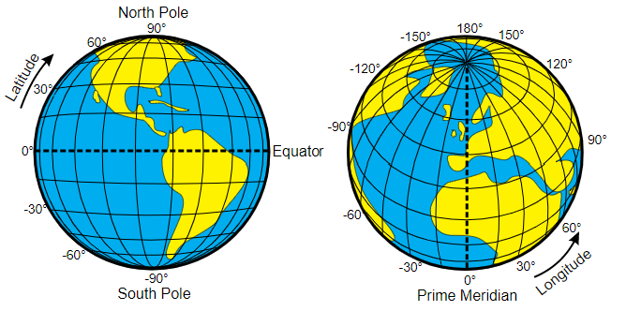
13.6.1 Warm-Up: Latitude and Longitude
In ancient times, people used landmarks to identify locations, but travelers were not familiar with local landmarks, making traveling difficult. Hipparchus, a Greek astronomer, was the first to specify location using latitude and longitude as coordinates. Hipparchus applied his knowledge of spherical angles to the problem of denoting locations on the Earth’s surface.
Latitude is the measurement of the globe north to south, and longitude is the measurement of the globe east to west.
volume 2, pg. 315

Slide 7
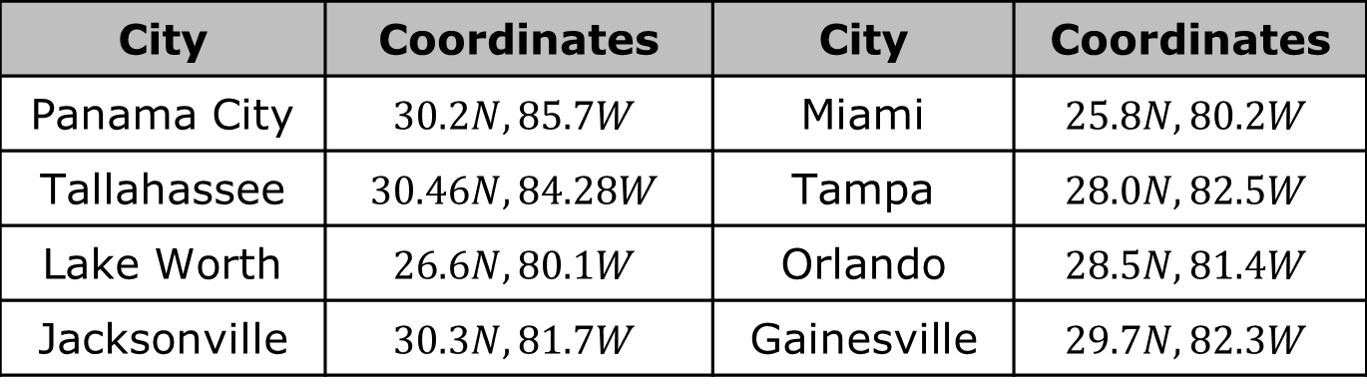
The table shows the latitude and longitude of different Florida cities.
What do you notice? What do you wonder?
City | Coordinates | City | Coordinates
Panama City | $$30.2N, 85.7W$$ | Miami | $$25.8N, 80.2W$$
Tallahassee | $$30.46N, 84.28W$$ | Tampa | $$28.0N, 82.5W$$
Lake Worth | $$26.6N, 80.1W$$ | Orlando | $$28.5N, 81.4W$$
Jacksonville | $$30.3N, 81.7W$$ | Gainesville | $$29.7N, 82.3W$$
volume 2, pg. 315

Slide 8

Refresher
volume 2, pg. 315

Slide 9

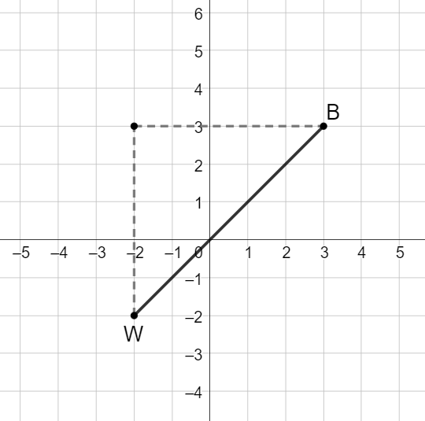
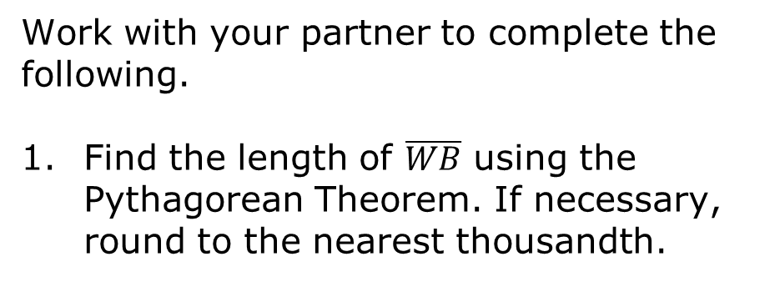
13.6.2 Refresher: Finding Distance
Work with your partner to complete the following.
Find the length of $\overline{WB}$ using the Pythagorean Theorem. If necessary, round to the nearest thousandth.
volume 2, pg. 315

Slide 10
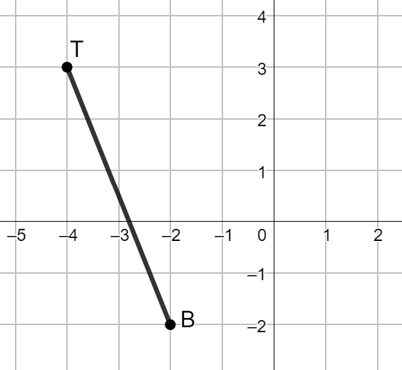
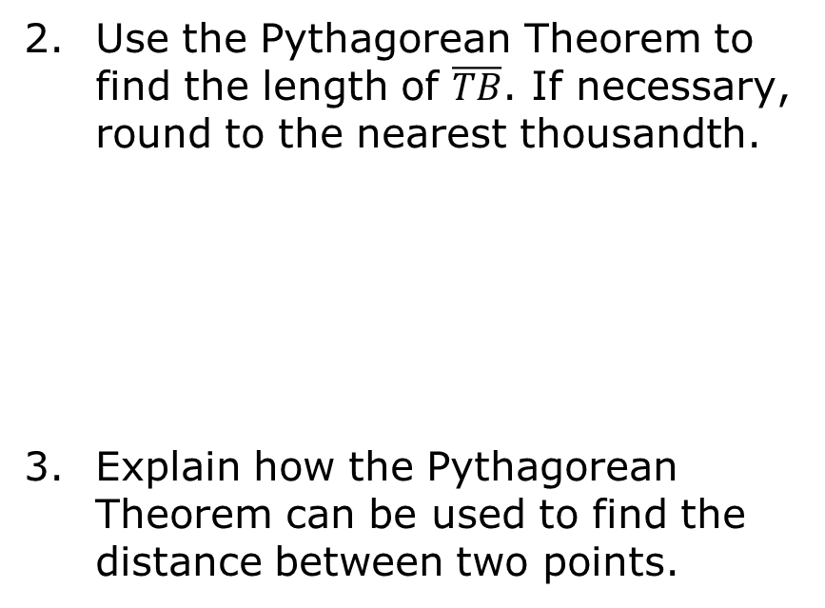
Use the Pythagorean Theorem to find the length of $\overline{TB}$. If necessary, round to the nearest thousandth.
Explain how the Pythagorean Theorem can be used to find the distance between two points.
volume 2, pg. 316

Slide 11

Exploration
volume 2, pg. 316

Slide 12

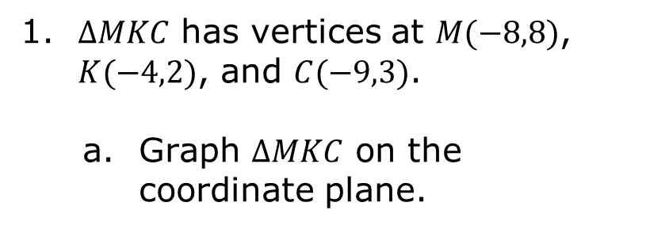
13.6.3 Exploration: Classifying Triangles
$∆MKC$ has vertices at $M(−8,8)$, $K(−4,2)$, and $C(−9,3)$.
Graph $∆MKC$ on the coordinate plane.
volume 2, pg. 316

Slide 13
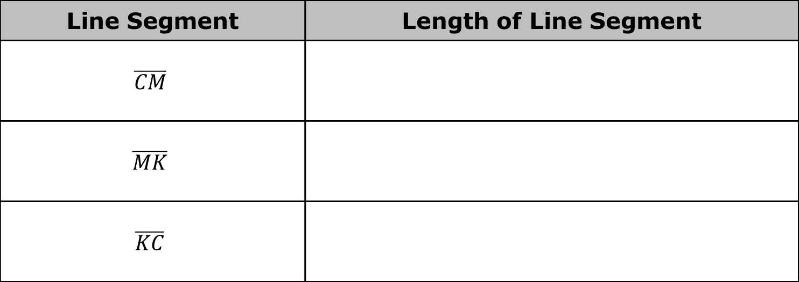
Complete the table. If necessary, round to the nearest thousandth.
Line Segment | Length of Line Segment
$$\overline{CM}$$
$$\overline{MK}$$
$$\overline{KC}$$
volume 2, pg. 316

Slide 14
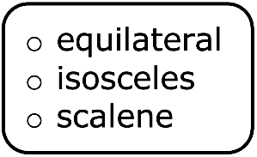

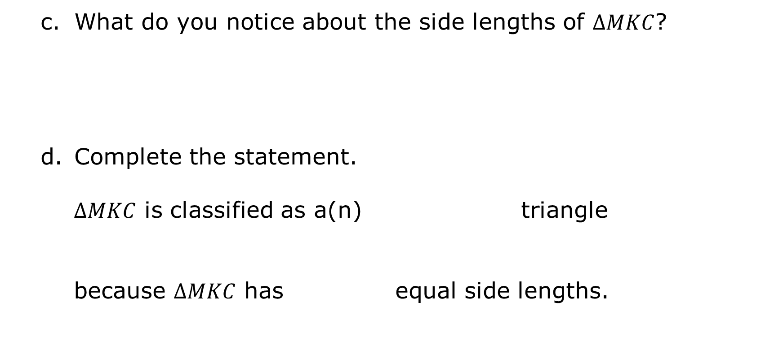
What do you notice about the side lengths of $∆MKC$?
Complete the statement.
$∆MKC$ is classified as a(n) triangle
because $∆MKC$ has equal side lengths.
volume 2, pg. 317

Slide 15
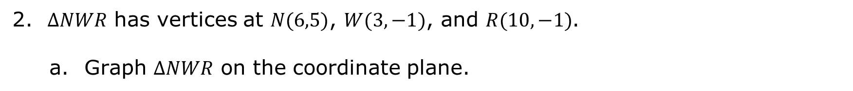
$∆NWR$ has vertices at $N(6,5)$, $W(3,−1)$, and $R(10,−1)$.
Graph $∆NWR$ on the coordinate plane.
volume 2, pg. 317

Slide 16

Complete the table. If necessary, round to the nearest thousandth.
Line Segment | Length of Line Segment
$$\overline{NR}$$
$$\overline{RW}$$
$$\overline{WN}$$
volume 2, pg. 317

Slide 17
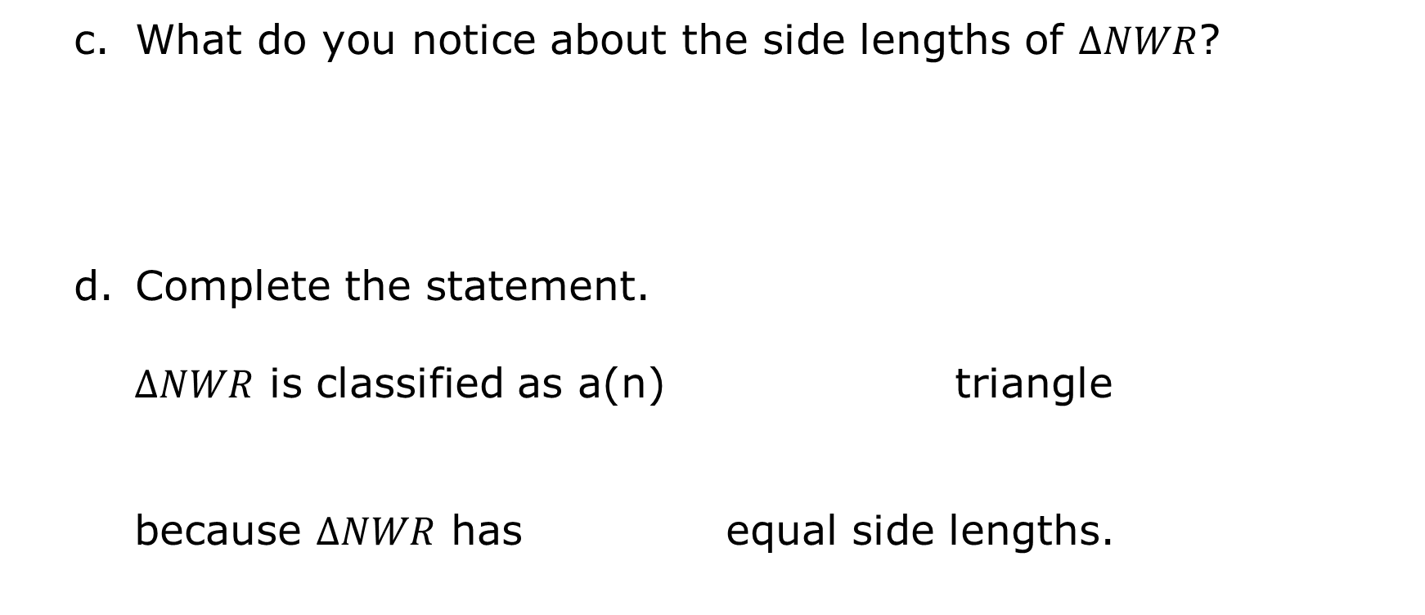
What do you notice about the side lengths of $∆NWR$?
Complete the statement.
$∆NWR$ is classified as a(n) triangle
because $∆NWR$ has equal side lengths.
volume 2, pg. 317

Slide 18
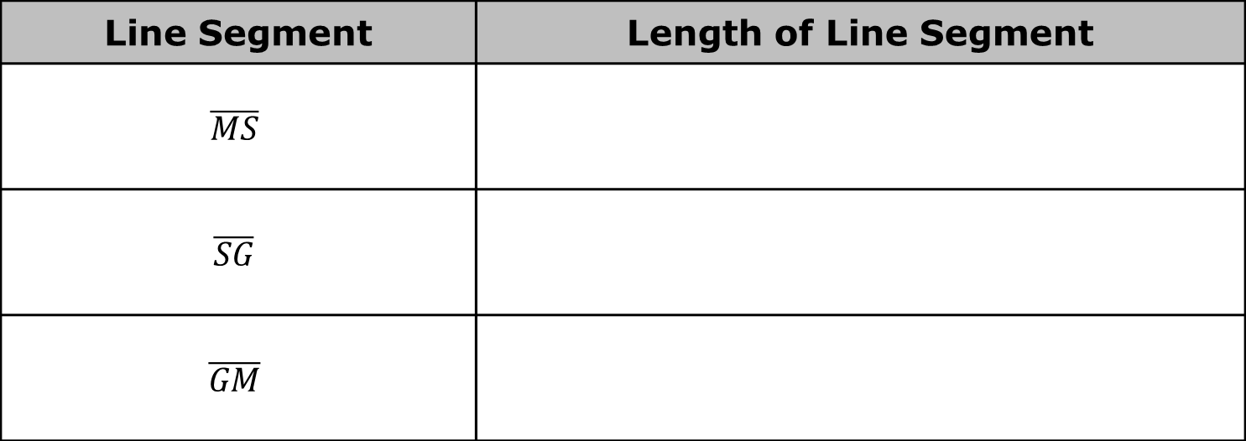
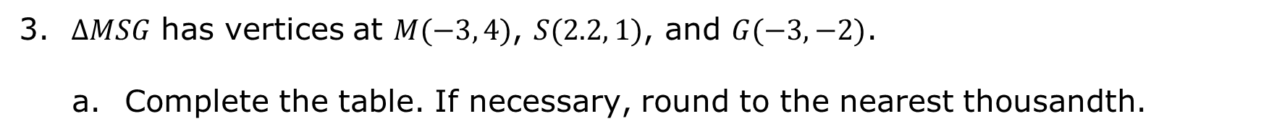
$∆MSG$ has vertices at $M(−3, 4)$, $S(2.2, 1)$, and $G(−3, −2)$.
Complete the table. If necessary, round to the nearest thousandth.
Line Segment | Length of Line Segment
$$\overline{MS}$$
$$\overline{SG}$$
$$\overline{GM}$$
volume 2, pg. 318

Slide 19
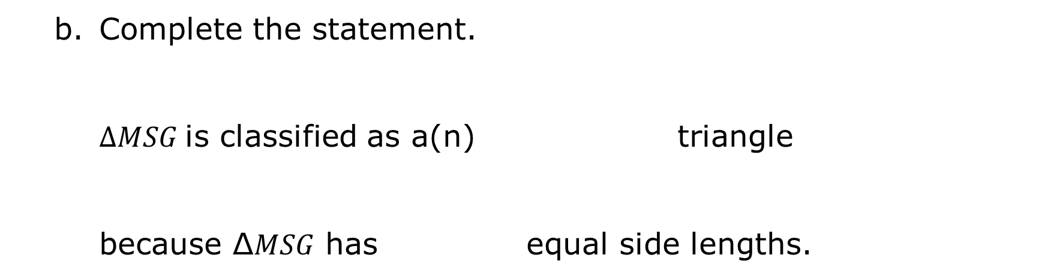
Complete the statement.
$∆MSG$is classified as a(n) triangle
because ∆𝑀𝑆𝐺 has equal side lengths.
volume 2, pg. 318

Slide 20
Draw a scalene triangle with one vertex at $(−3,6)$ and with a base that is twice the length of its height.
volume 2, pg. 318

Slide 21

Your Turn
volume 2, pg. 319

Slide 22
13.6.4 Your Turn!
$∆PTH$ has vertices at $P(−2,3)$, $T(3,1)$, and $H(0,−2)$. Determine if $∆PTH$ is an equilateral, isosceles, or scalene triangle. Justify your answer with math.
volume 2, pg. 319

Slide 23
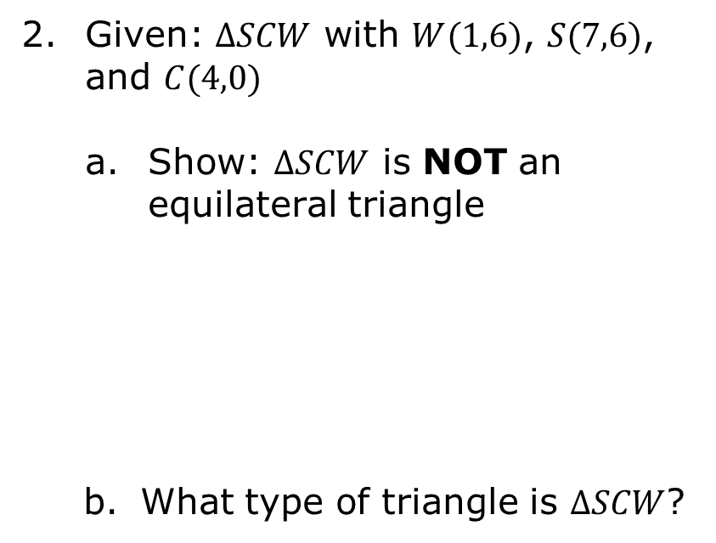
Given: $∆SCW$ with $W(1,6)$, $S(7,6)$, and $C(4,0)$
Show: $∆SCW$ is NOT an equilateral triangle
What type of triangle is $∆SCW$?
volume 2, pg. 319

Slide 24
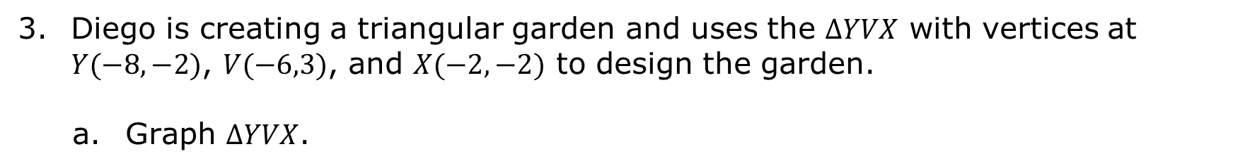
Diego is creating a triangular garden and uses the $∆YVX$ with vertices at $Y(−8,−2)$, $V(−6,3)$, and $X(−2,−2)$ to design the garden.
Graph $∆YVX$.
volume 2, pg. 320

Slide 25

Complete the table. If necessary, round to the nearest thousandth.
Classify the type of triangular garden Diego is creating.
Line Segment | Length of Line Segment
$$\overline{YV}$$
$$\overline{VX}$$
$$\overline{XY}$$
volume 2, pg. 320

Slide 26
Draw an isosceles triangle whose base is three more than the height of the triangle and has one vertex at $(2, 5)$.
volume 2, pg. 320

Slide 27

Wrap-Up
volume 2, pg. 321

Slide 28
13.6.5 Wrap-Up: Cool Down
Identify two strategies you can use to classify triangles using coordinate geometry.
volume 2, pg. 321

